Slide 1
UNIT THREE
LAPLACE TRANSFROM AND TRANSIENT ANALYSIS
DR (MRS) E. A. ADJEI

Slide 2
LAPLACE TRANSFROM TECHNQUES
The Laplace transform of a function f(t) is denoted by . The inverse Laplace transform of f(s) is denoted by L-1[F(s)]. Of f(t).
Laplace transform method is used extensively to facilitate and systematize the solution of ordinary constant – coefficient equations. It is used to analyze Linear – Time – Invariant systems. LTI systems are equations in which none of the terms depends explicitly on the independent variable, time.

Slide 3
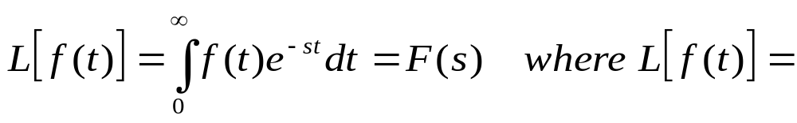
Definition of Laplace Transform
Laplace transform function is given as
Evaluation of the integral results in a function F(s) that has ‘s’ as the parameter. This parameter, ‘s’ is a complex quantity of the form 0 +jw. Since the limits of integration are zero and infinity, it is immaterial what value f(t) has for negative or zero time. There are limitations on the function f(t) that are Laplace-transformable. Basically, the requirement is that at the Laplace integral converge, which means that this integral has a definite functional value.

Slide 4
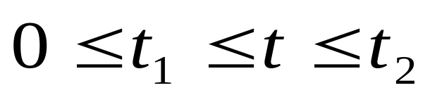
Laplace Transform
The function f(t) must be piecewise continuous in a finite time interval
A function is piecewise continuous in a finite interval if that interval can be divided into finite number of subintervals, over each of which the function in continuous and at the ends of each of which f(t) possesses finite right and left hand limits.

Slide 5
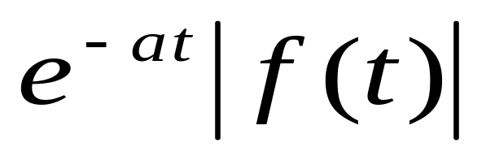
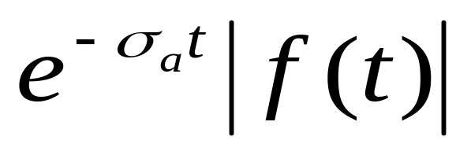
Laplace Transform
A function f(t) is of exponential order if there exists a constant ‘a’ such that the product
is bounded for all values of t greater than some finite value T.
This imposes the restriction that σ, the real part of s, must be greater than a lower bound σ_{a} for which the product
is of exponential order.
A linear differential equation whose constant co-efficient s and finite number of terms is Laplace transformable if the driving function is Laplace-transformable.

Slide 6
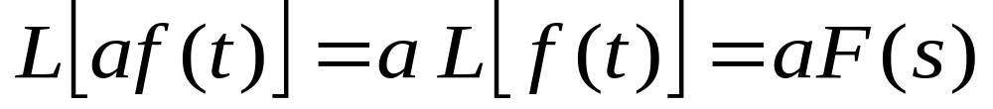
Laplace Transform Theorems
Several theorems are useful in applying the Laplace transform are presented below:
Theorem I: Linearity: If ‘a’ is a constant or is independent of ‘s’ and ‘t’, if f(t) is transformable, then
Theorem II: Superposition; If f₁(t) and f₂(t)are both Laplace-transformable, then the principle of superposition applies:

Slide 7
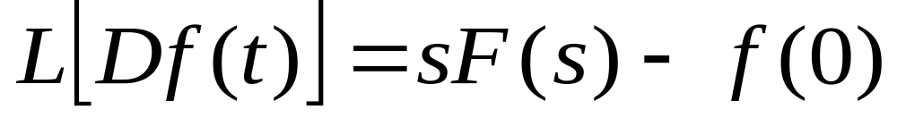
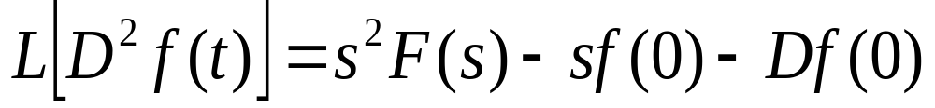
Laplace Transform Theorems
Theorem III: Real Differentiation; If the Laplace transform of f(t) is F(s) and if the first derivative of f(t) with respect to time, Df(t), is transformable, then
The term f(0) is the value of the function f(t) evaluated at the origin t = 0.
The transform of the second derivative D²f(t) is:
Where Df(0) is the value of the limit of the derivative of f(t) at the origin t = 0.

Slide 8
Laplace Transform Theorems
The transform of the n^{th} derivative D^{n}f(t) is
Note that the transform includes the initial conditions, whereas in the classical method of solution, the initial conditions are introduced separately to evaluate the co-efficients of the solution of the differential equation.

Slide 9
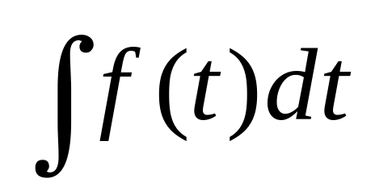
Laplace Transform Theorems
Theorem IV: Real-Integration
If f(t) is of exponential order, then the Laplace transform of
exists and is given by

Slide 10
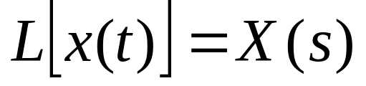
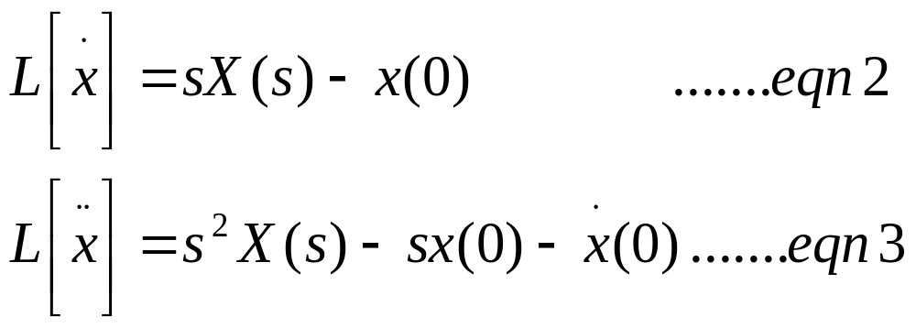
Example
Find the solution x(t) of the differential equation
where ‘a’ and ‘b’ are constants.
Solution:
By writing the Laplace transform of X(t) or , we obtain
Substituting eqn (3) and eqn (2) into eqn (1), we have

Slide 11
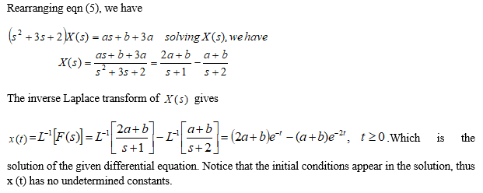
Example

Slide 12
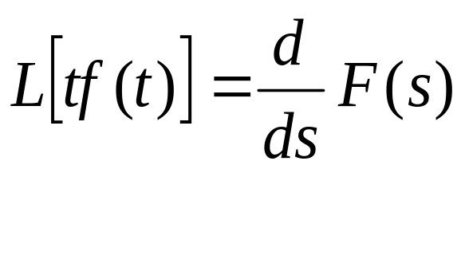


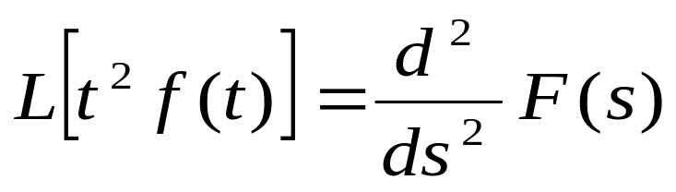
Laplace Transform Theorem
Theorem V: Complex differential:
If f(t) is a Laplace transformable, then except at poles of F(s).
Where = . This is known as the complex differential theorem. Also
.

Slide 13
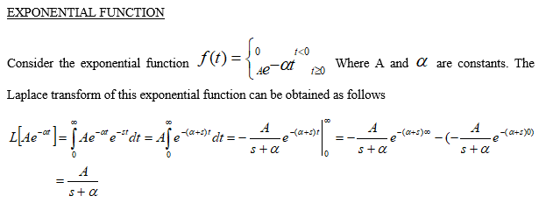
EULER THEROEM (POWER SERIES)

Slide 14
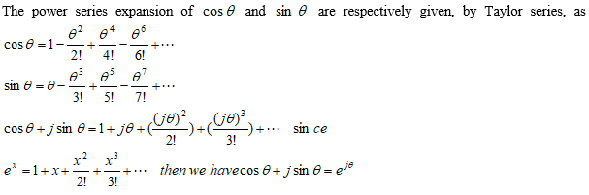
EULER THEROEM (POWER SERIES)

Slide 15
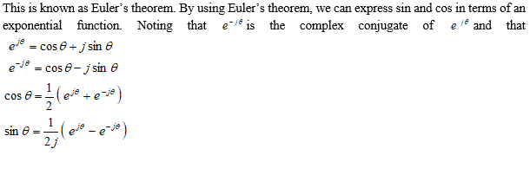
EULER THEROEM (POWER SERIES)

Slide 16
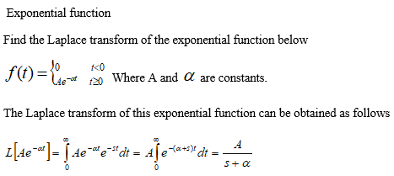
Example 1

Slide 17
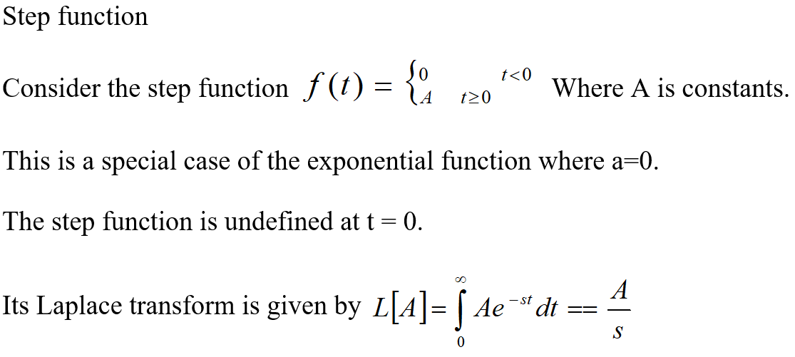
Example 2

Slide 18
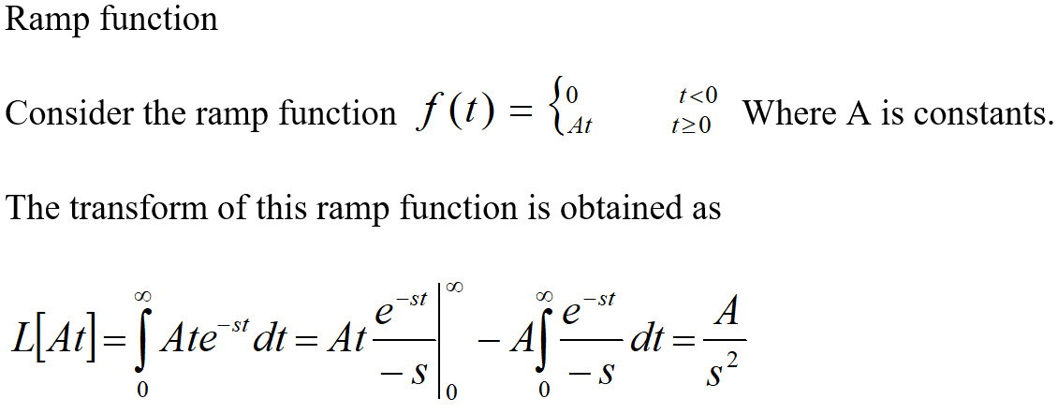
Example 3

Slide 19
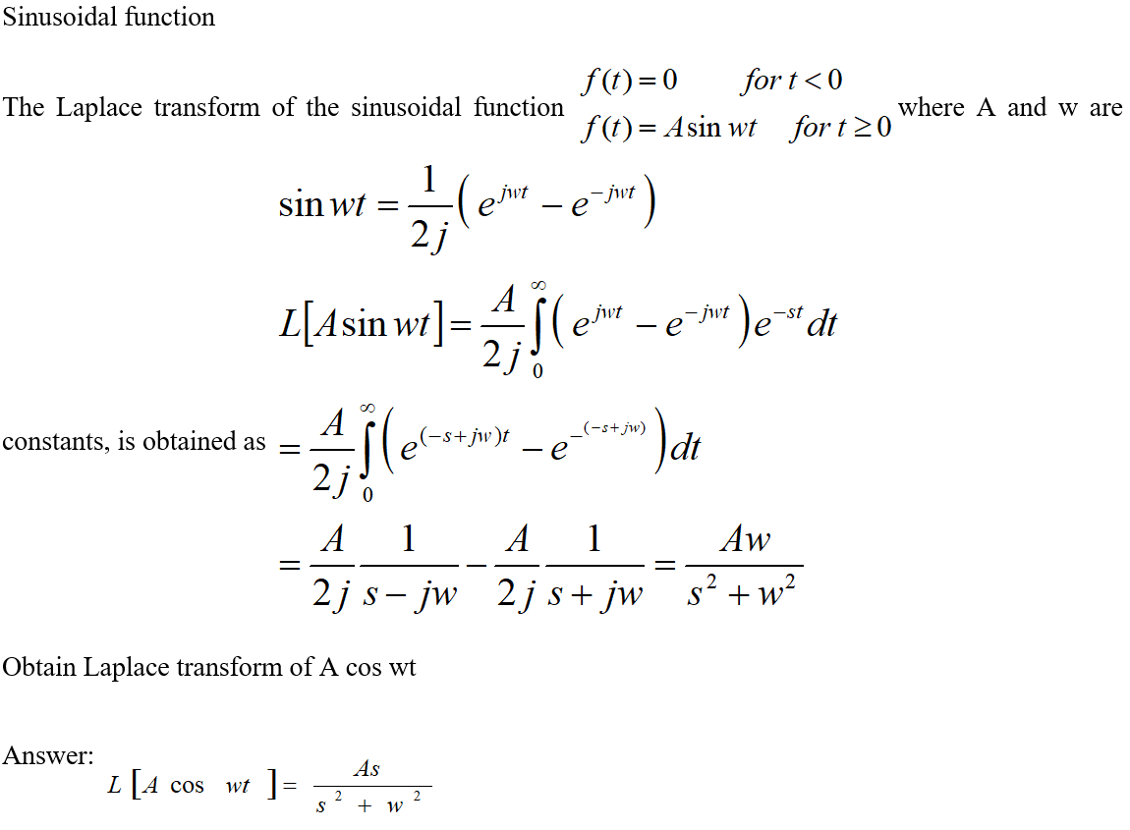
Example 4

Slide 20
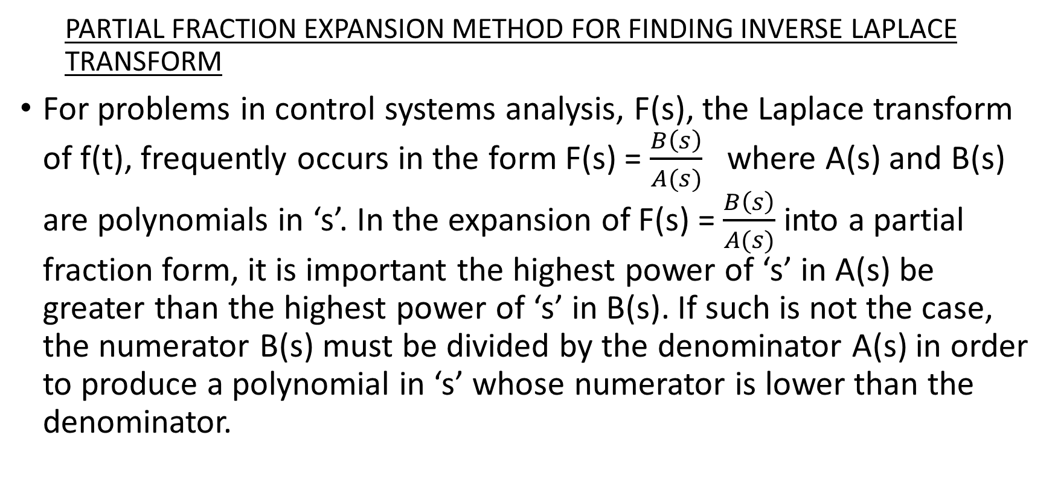
INVERSE LAPLACE TRANSFORM
  PARTIAL FRACTION EXPANSION METHOD FOR FINDING INVERSE LAPLACE TRANSFORM
For problems in control systems analysis, F(s), the Laplace transform of f(t), frequently occurs in the form F(s) = $\frac{B\left(s\right)}{A(s)}$ where A(s) and B(s) are polynomials in ‘s’. In the expansion of F(s) = $\frac{B\left(s\right)}{A(s)}$ into a partial fraction form, it is important the highest power of ‘s’ in A(s) be greater than the highest power of ‘s’ in B(s). If such is not the case, the numerator B(s) must be divided by the denominator A(s) in order to produce a polynomial in ‘s’ whose numerator is lower than the denominator.

Slide 21
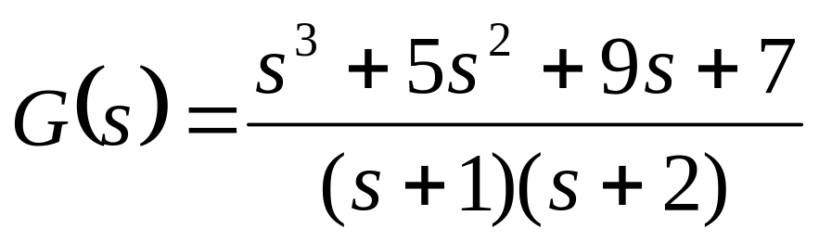
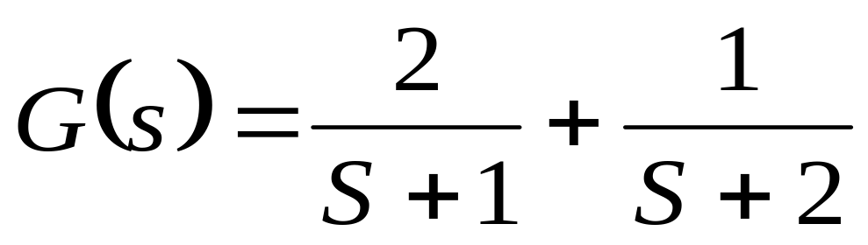
Partial Fraction Expansion Method for Finding Inverse Laplace Transform
Example
Here, since the degree of the numerator polynomial is higher than that of the denominator polynomial, we must divide the numerator by the denominator. We have

Slide 22
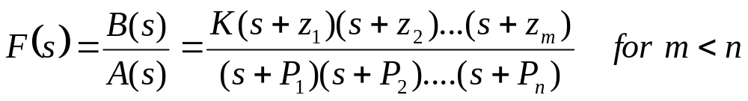
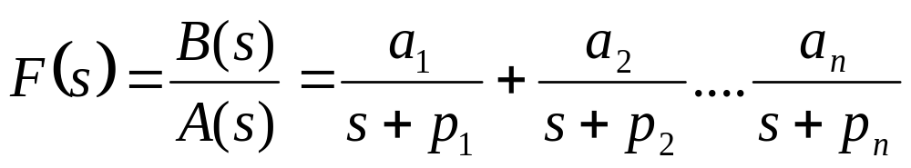
Partial Fraction Expansion When f(s) Involves Distinct Poles Only
Consider F(s) written in the factored form
Where P₁,P₂₁,……P_{n} and z₁, z₂,…z₃ are either real or complex quantities, but for each complex P_{i} or z_{i} there will occur the complex conjugate of P_{i} or z_{i}, respectively. If F(s) involves distinct poles only, then it can be expanded into a sum of simple partial fractions as follows:

Slide 23
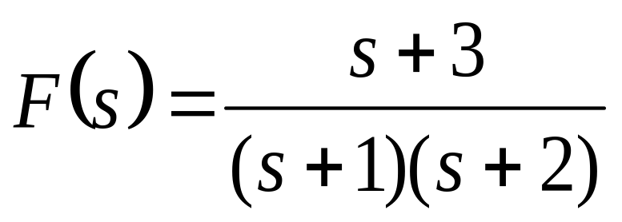
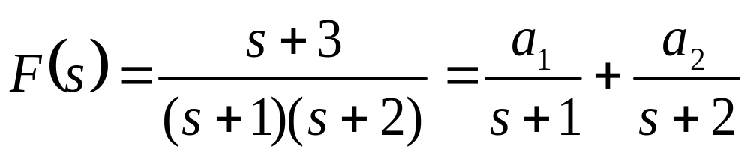
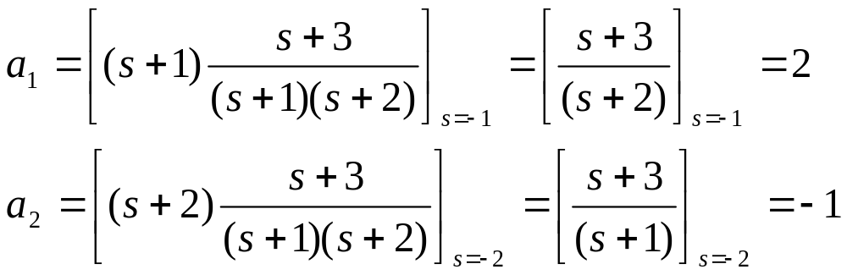
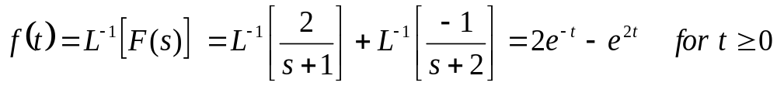
Partial Fraction Expansion Method for Finding Inverse Laplace Transform
E.g. Find the Laplace transform of
The partial fraction expansion of F(s) is
Thus

Slide 24
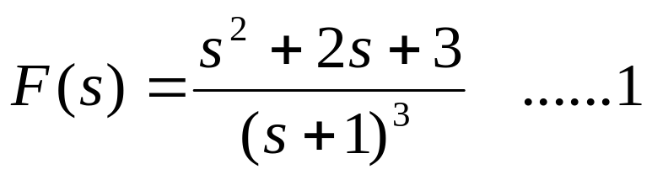
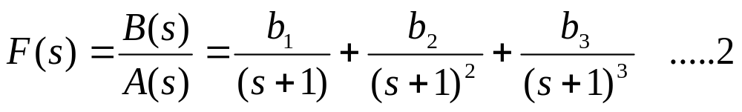
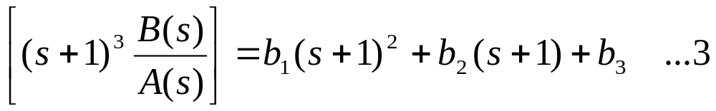
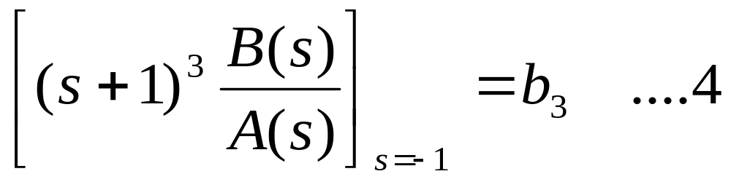
Partial Fraction Expansion When f(s) Involves Multiple Poles
Example:
The partial fraction expansion of this F(s) involves three terms.
Whereb₁,b₂,b₃ are determined as
• Multiply both sides of the equation by (s+1)³, we have
letting s = -1

Slide 25
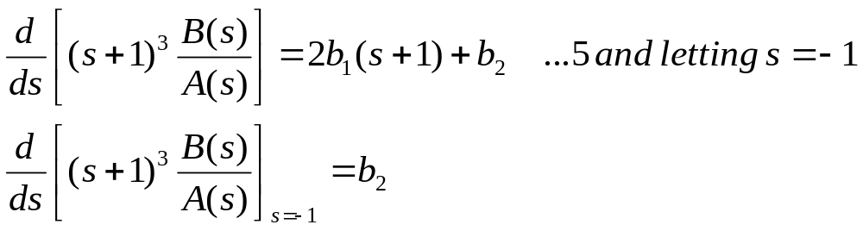
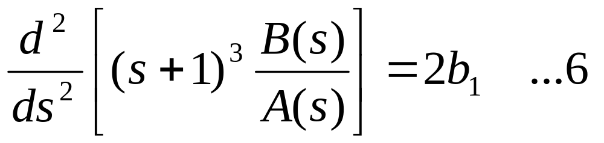
Partial Fraction Expansion When f(s) Involves Multiple Poles
Differentiating both sides of the equation with respect to ‘s’ yields
By differentiating both sides of equation 5 with respect to ‘s’, the result is

Slide 26
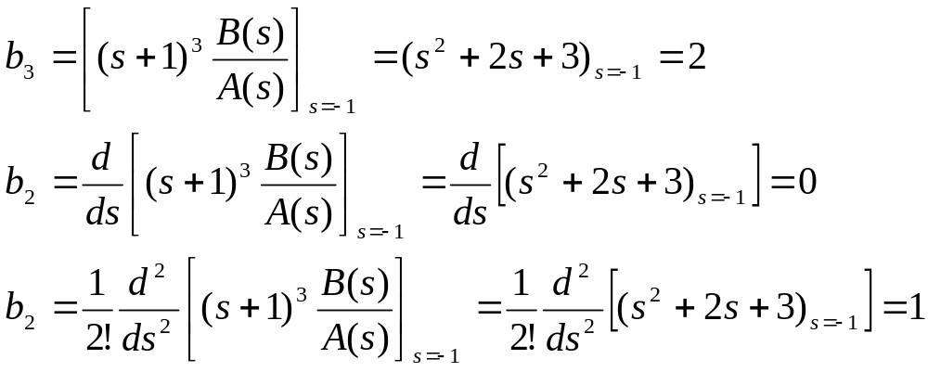
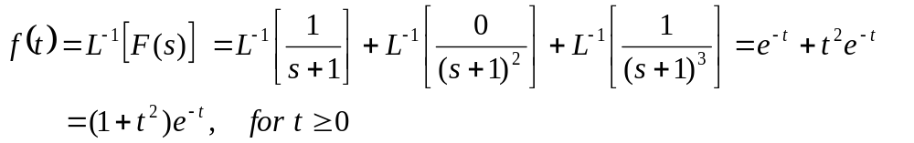
From the proceeding analysis it can be seen that the values b₁, b₂,b₃ are found systematically as
We obtain

Slide 27
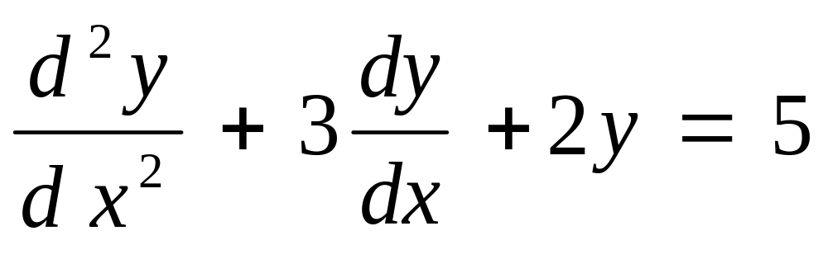
SOLVED TUTORIAL PROBLEMS
Using Laplace transform, solve the following equations with zero initial conditions.

Slide 28
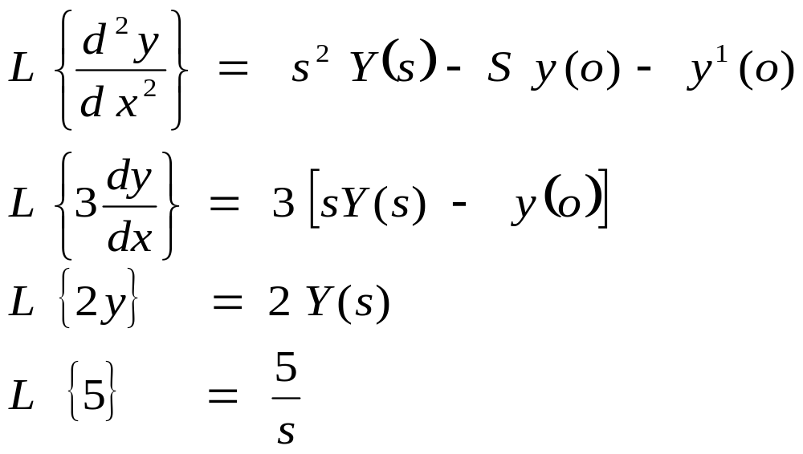
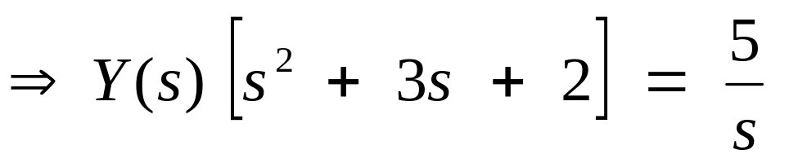
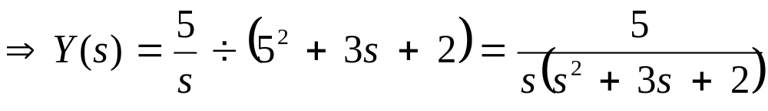
Solution
s² Y(s) – s y(0) – y¹(0) + Y(s) – 3 y(0) + 2 Y(s) = 5/ s

Slide 29
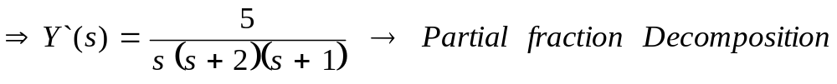
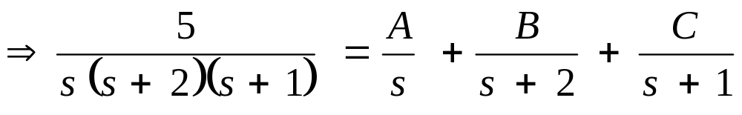
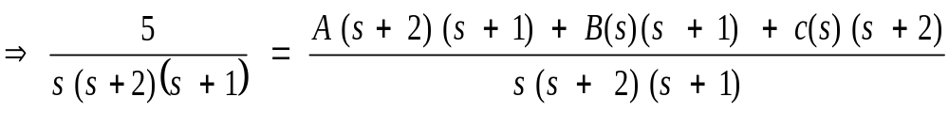
Solution

Slide 30
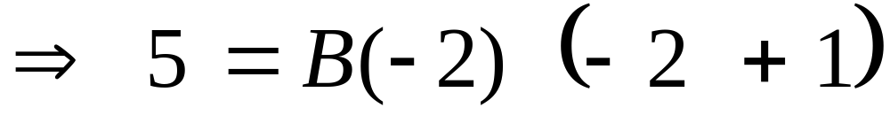
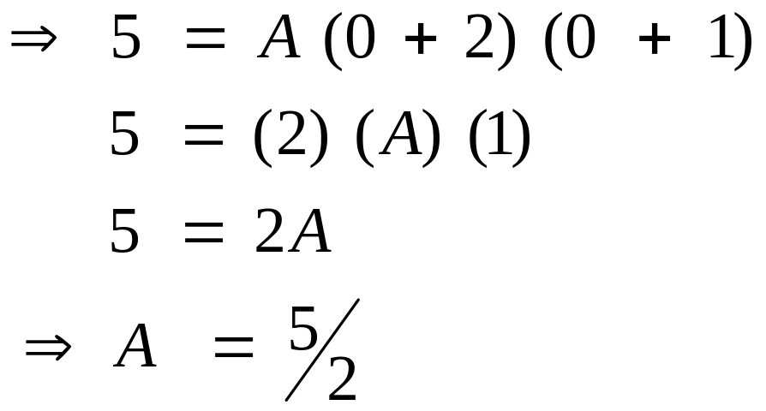
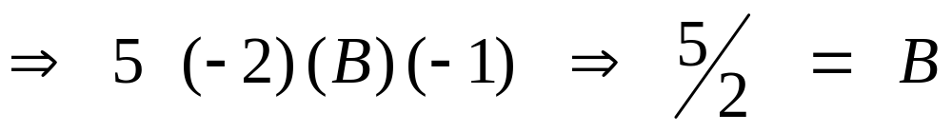
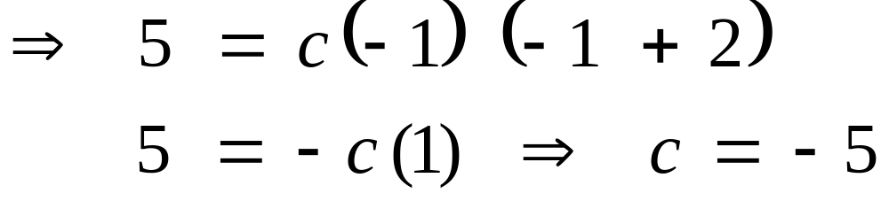
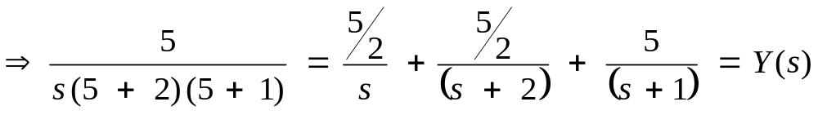
Solution
Using the Heaviside cover up method;
For Residue B, s = -2
For Residue C, s = 1

Slide 31
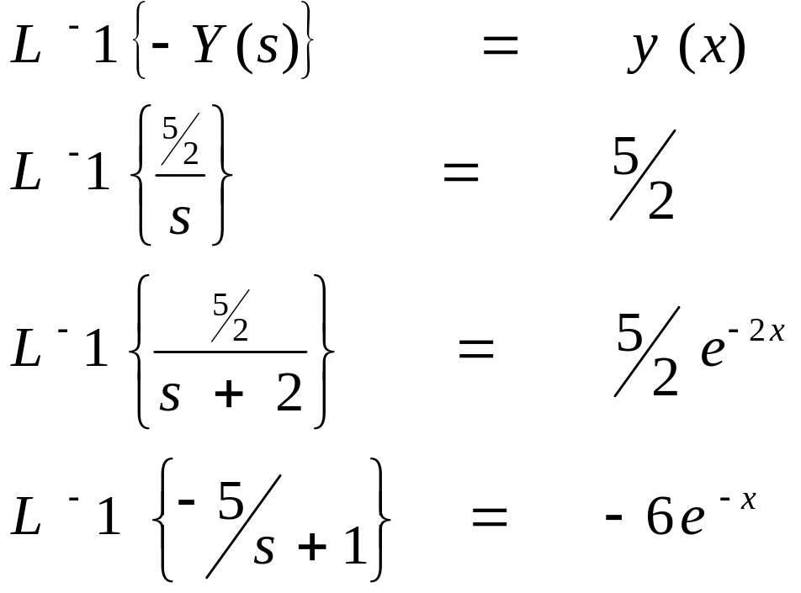

Solution
Taking the Laplace Inverse;
Solution for the differential equation is:

Slide 32



Example 2
As initial conditions are zero, taking Laplace transform on both sides and assuming u(t) = x
s³ Y(s) + 10s² Y(s) + 20s Y(s) + 5 Y(s) = 8X(s)
On rearranging,

Slide 33




Example 2

Slide 34




Example 2

Slide 35

Example 3
Calculate the current (t) in the integral differential equation.
Assume initial conditions to be zero.

Slide 36



Example 3 - Solution
Taking Laplace transform of both sides of equation,
Substituting initial conditions to be zero i.e. I(o⁺) = o

Slide 37


Solution
The equation above contain single order poles. Using partial fraction method;
Substituting these partial factor coefficients and taking inverse Laplace transform;

Slide 38

Example 3
Find the inverse Laplace transform of
$F\left(s\right)=\frac{10}{\left[s\left\{s + 2\right)\left\{s + 3\right)2\right]}$
Answer
$f\left(t\right)=\frac{5}{9}−5e^{−2t}+\frac{10}{3}te\left(−3t\right)$

Slide 39


Exercises
Given the function f(t), find F(s)
f(t)= 17
$f\left(t\right)=20t^{2}$
$f\left(t\right)=3t^{2}+9t−2$
$f\left(t\right)=\frac{25}{10} (1−e^{−10t})$
$f\left(t\right)=2.5 (1−e^{−10t})$
$f\left(t\right)=3.2 sinωt$
$f\left(t\right)=8(e^{−t/6}−e^{−t/12}$)
In the following expressions, find f(t) for the given F(s) functions:
$F\left(s\right)=\frac{22}{{\left(S+1\right)}^{2}}$
$F\left(s\right)=\frac{5}{s\left(0.02s+1\right)}$
$F\left(s\right)=\frac{100}{s^{2}+1000}$

Slide 40
TRANSIENT ANALYSIS
Transient analysis means analyzing a system in unsteady state. If the variables involved in defining the state of a system does not vary with respect to time, then the system is said to be in steady state. If not, it is in unsteady state
A hot coffee put in air. (transient heat transfer)
Just after switching on a capacitive circuit. (transient voltage-current characteristic in capacitor)
An iron piece exposed to carbonaceous environment during surface hardening process. (transient mass transfer)

Slide 41
TIME RESPONSE OF CONTROL SYSTEMS
We can analyze the response of control systems in both the time domain and the frequency domain. If the output of a control system for an input varies with respect with time, then it is called the time response of the control system. The time response consists of two parts:
Transient response and
Steady state response
Control Test Inputs
Examples of standardized control inputs are:
Step input, ramp function, impulse function, parabolic function, etc.

Slide 42

Step Function
For example, by switching a voltage in an electrical circuit or a sudden force which is retained in a mechanical network. If it is assumed that the step is of unit magnitude and is applied at t=0, the unit step input is a primary test signal can be described by
where the input magnitude is shown to be unity after time t=0. The Laplace transform of the ideal unit step is given by U(s) =1/s
U(t)
t
Unit Set Input Signal

Slide 43
Impulse function
This is a simple derivation of the step input. It therefore has a Laplace transform of U(s) = 1 when applied as a control signal. In its strictest form, an impulse function last for a time interval δt as δt tends to 0, and is of infinite magnitude.
As the practical application of such a signal poses obvious problems, it is usual to approximate the impulse with a signal of unit magnitude which lasts for a very short time period δt.

Slide 44


Ramp Input
If the integral is taken of the step input, this results in a function which increases linearly with respect to time from a zero value at time t = 0. The ramp function which can also be regarded as velocity function is shown in terms of a unit magnitude ramp in fig2.
The unit ramp input can be written as U(s) =1/s²
U(t)
Unit Ramp Input Signal
t

Slide 45


Parabolic input
By integrating the ramp function, hence obtaining an acceleration function, a square law signal known as the parabolic function is achieved. This is shown in terms of a unit parabolic signal in figure.
The unit parabolic input can be written as
Where the division by 2 is included in order
to think of the function as a step acceleration
term with respect to the original step input.
This can also be considered as U(s) =1/s3
By means of the Laplace transform.

Slide 46





Parabolic input
It is apparent that by combining the step, ramp and parabolic inputs to form one single input signal, for all t>0, this can be written as
It is quite possible, however, to consider further integrated terms in order to arrive at an overall input, although a more general
expression is obtained by considering each separate term to have a magnitude equal to a constant d_{i}, resulting in a power series or polynomial function for t>0; U(t) = 0 for t<0.
This polynomial function can be written more concisely as
where d_{i} are scalar constant values. The final standard test
signal introduced here is the sinusoidal function which can be written in unit magnitude form as

Slide 47
TIME DOMAIN PERFORMANCE CRITERIA
TIME RESPONSE
The initial part of the response is most often described by means of two terms, firstly the delay time, which is the time taken for the output step response to reach 50% of it’s final value. Secondly, the rise time which is the time taken for the output to rise from 10% to 90% of its final value.
At a later stage in the time response, we have the settling time. This is defined as the time taken for the step response to reach and stay within a specified percentage of its final value. A commonly encountered figure is 5%.

Slide 48
TIME RESPONSE
Maximum overshoot: it is the maximum difference between the transient and steady-state step response values that occurs after the response has first passed its final value. It is frequently written as a percentage of the steady-state output response value,
Maximum overshoot = (maximum overshoot/ steady-state value) X 100%
A single input-output linear dynamic system transfer function G(s) relates input, U(s), to output, Y(s) as : Y(s) = G(s)U(s)
To control output Y(s), adjust U(s) by means of a controller K(s), so that
Y(s) = K(s)G(s)U(s) and if K(s)G(s)=1 , the output Y(t) will follow reference input r(t).

Slide 49
STEP RESPONSE
A step response is a system’s response to a step function. The response function is also called the unit step response. When measuring a system’s step response, a signal is applied at the system input that jumps from zero to 1 at the time t₀. The input signal remains unchanged for the duration of the measurement.
The step response of multi-input systems is the collection of step responses for each input channel. Step response and transfer function are interchangeable via Laplace transform
Performance indices
  Peak time
  Settling time
  Rise time
  Steady state error
  Percentage overshoot
Example: step, Ramp and Parabolic inputs

Slide 50



Step Response
Applying step input to a first order system transfer function, we have
where K is the system gain, then the system output is obtained from Y(s) = G(s)U(s) to be
in which 1/s is the unit step Laplace transform. The output then is

Slide 51


SECOND ORDER SYSTEMS
General second order system
1. Under-damped case (0<ξ<1): in this case C(s)/R(s) can be written for general second order system
Second order system.
Damped systems
Under damped
Critically damped
Over damped

Slide 52
Effects of Damping ratio
if ξ<0, then the poles will be right-half-plane (have positive real parts), and the system will be unstable.
If ξ=0, so s=±w_{n}j, the system will be marginally stable or neutrally stable, e.g 0±5j
If 0<ξ<0.707, the system response will be oscillatory and under damped with very small overshoot.
If 0.707<ξ<1, the system response will be oscillatory and under-damped. The poles are in the left half of the s-plane
If ξ = 1, the system response will be critically damped (no overshoot) There are two real equal negative poles.
If ξ>1, the system response will be over-damped with two real negative poles with no overshoot.

Slide 53




Example
Second order system =
Also2
Hence the system is critically damped

Slide 54






For a critical damped system, the response is as follow
Putting tan⁻¹
Since,

Slide 55






Now
And
Hence

Slide 56








1. Rise time for a critically damped system, tr = t_{90%} - t_{10%}
Steady state response y
= 1 –
taking natural log of both sides

Slide 57






ii.
Approximate methods can be used to solve this equation
y(t_{10%}) = 0.1772705361s
Similarly,
Check with Matlab tr = 1.12s exact!

Slide 58





(iii) Peak time, tp occurs at y(t)_{max}
y(t)_{max} occurs when

Slide 59


Setting time, ts_{2%} occurs at y(ts_{2%}) = 0.98
Similarly ts_{5%} occurs at y(ts_{5%}) = 0.95
Check Matlab ts2% = 1.94s exact!

Slide 60




Maximum overshoot y_{max} occurs at y(tp)
If tp = 0
If tp = ∞

Slide 61
Stability Analysis
Stability deals with asymptotic behaviour of a system for all inputs as time approaches infinity. Absolute stability deals with qualitative nature (yes/no). Relative stability deals with how close a system is to being unstable, (how stable).
Linear system is stable if all the poles of the closed loop transfer function, y(s)/r(s), lie the left half of the s – plane. This is a necessary and sufficient condition for the system to be stable.
If the system has some roots with real parts equal to zero, but none with positive real parts, the system is said to be marginally stable. Example S2 + 1 = 0. the roots are ±j, since these roots have no roots with positive real part but only imaginary values, the system is marginally stable.

Slide 62

Routh Stability Criterion
The Routh criterion is a method for determining continuous system stability, for systems with an nth-order characteristic equation of the form;
The criterion is applied using a Routh table defined as follows
S^{n} S^{n-1} S¹ S⁰ | a_{n} a_{n-2} a_{n-4} ------- a_{n-1} a_{n-3} a_{n-5} -------- b₁ b₂ b₃ --------- c₁ c₂ -------- d₁

Slide 63

Routh Criterion
Where an , a_{n-1}, ……, a₀ are the co-efficients of the characteristic equation and
This method provides a way of determining the stability of a closed loop system from the co-efficient of the closed loop characteristic equation without computing its roots.
The Routh Criterion: all roots of the characteristic equation have negative real parts if and only if the elements of the first column of the Routh table have the same sign. Otherwise, the number of roots with positive real parts is equal to the number of changes of sign.

Slide 64
Example 2: S³ + 3S² +3S + 1+K = 0.
S³ S² S¹ S⁰ | 1 3 0 0 3 1+K 0 (8-K)/3 0 1+K
For no sign changes in the first column, it is necessary that the conditions 8-K>0,

Slide 65
1 + K>0 be satisfied. Thus the characteristic equation has roots with negative real parts if -1<K<8, the simultaneous solution of these two inequalities.
A row of zeroes for the S¹ row of the Routh table indicates the at the polynomial has a pair of roots which satisfy the auxiliary equation formed as follows: AS² +B= 0. Where A and B are the first and second elements of the S² row.
To continue the table, the zeroes in the S¹ row are replaced with the co-efficients of the derivative of the auxiliary equation. The derivative of the auxiliary equation is 2AS + 0 = 0. The co-efficients 2A and 0 are then entered into the S1 row.

Slide 66
Example 3: S⁴+ 6S³ + 11S² +6S + 15 = 0.
S⁴ S³ S² S¹ S⁰ | 1 11 15 0 0 6 6 0 10 15 0 -3 0 15
This system is unstable

Slide 67
Consider the polynomial equation S³ + 6S² +11S + 6 = 0. The Routh array is
S³ S² S¹ S⁰ | 1 11 0 6 6 0 10 0 6
This system is stable
Try: S³ + 4S² +8S +12 = 0, S⁴ + S³ - S -1 = 0, S⁴+ S³ + S² +11S + 10 = 0.

Slide 68
Special Cases
There are three (3) special cases that have to be considered.
1. There is a zero in the first column, but other elements in the row are non-zero.
2. All elements in the row are zero.
3. All elements in the row are zero and there are repeated roots on the imaginary axis.
CASE 1: Zero only in the first column.
The way to deal with this occurrence is to replace the zero with a very small positive number, ε, and to complete the array.

Slide 69
For example: S⁵+ 2S⁴ + 2S³ + 4S² +11S + 10 = 0. Then the array is
S⁵ S⁴ S³ S² S¹ S⁰ | 1 2 11 0 0 0 2 4 10 0 0 ε 6 0 0 (4ε-12)/ε (10ε)/ε 0 (-72/ε-10ε)/(-12/ε) 10
NB: the 4 is ignored since a very small value compared with the 12. There are two sign changes as ε tends to zero.

Slide 70
CASE 2: Zeroes in a row
If the whole row is zeroes (even if the element has just one element), then there are poles that are symmetric about the origin of the s – plane. Example: (S+1) (S-1). To solve it, the auxiliary polynomial U(s), which immediately precedes the zero entry in the Routh array, must be used. U(s) always has degree that is even, and indicates the number of symmetric poles pairs. For example: S³ + 2S² +4S + K = 0.
S³ S² S¹ S⁰ | 1 4 0 2 K 0 (8-K)/2 0 K
For a stable system, 0<K<8. If K=8, then the whole of the S¹ row is zero, so there are symmetric poles about the origin.

Slide 71

Auxiliary polynomial, U(s) = 2S² + K = 0. Factorizing U(s) will give the two symmetric poles,
The situation with the entire row of zero elements can be remedied by the following procedure:
Form the auxiliary equation U(s)=0 by using the co-efficients of the preceding row of zeroes.
Take the derivative of the auxiliary equation with respect to s, that is dU(s)/ds = 0
Replace the row of zeroes with the co-efficients of dU(s)/ds = 0
Continue the construction of the Routh array in the usual manner.

Slide 72
Example: S⁵+ 4S⁴ + 8S³ + 8S² +7S + 4 = 0.
The Routh array is
S⁵ S⁴ S³ S² S¹ S⁰ | 1 8 7 0 0 0 4 8 4 0 0 6 6 0 0 4 4 0 8 0 4
We get row of zeroes in the S¹ row, set U(s) =4 S² + 4 = 0 which gives us the root s±j = 0
Calculate dU(s)/ds = 8S
There are no sign changes in the first column, so the system has no right-half-plane poles

Slide 73
CASE 3: Repeated roots on the imaginary axis
The Routh – Hurwitz criterion indicates that a system has poles in the right half of the s-plane. A system needs poles in the left half plane for stability. A system with repeated poles on the imaginary axis results in an unstable system. Example: S⁵+ S⁴ + 2S³ + 2S² +S + 1 = 0. The Routh array is
S⁵ S⁴ S³ S² S¹ S⁰ | 1 2 1 0 0 0 1 2 1 0 0 4 4 0 0 1 1 0 ε 1
U(s) = S⁴ + 2S² + 1 = 0 (S² + 1) = 0 S = ±j dU(s)/ds = 4S³ + 4S
The system is unstable since there are repeated roots on the imaginary axis. But we know from the auxiliary polynomial that we have 2 poles on the imaginary axis, so the system is marginally stable.

Slide 74
Matlab Tutorials For System Stability Analysis
Introduction
In control engineering, in order to analyze and design control systems, a mathematical model of the actual plant is required. This model approximates the behaviour of the plant to some extent. By engineering requirement, a number of assumptions have to be made about the plant in order to obtain the model.
The nature and validity of the assumptions must be bear in mind when applying control theory to real engineering systems. Analysis and design taking into account the amount of difference between the actual plant and model is a more advanced topic, studied within an area known as robust control.

Slide 75
Matlab Tutorials For System Stability Analysis
One of the most common assumptions is that the plant is linear. This is valid for most plants within a certain limited operating range. The second assumption is that the plant dynamics are exactly known and are time invariant.
Again, this is valid to some extent, but the fact that the plant dynamics and system disturbances are not exactly known, and their characteristics change over time is what motivates the use of feedback.
Indeed, if the plant and disturbances were exactly known, there would be no need for feedback control; all control could be open-loop.
However, for the sake of designing the feedback controller, this assumption is made. Another common assumption is that the plant is second order.

Slide 76
Matlab Tutorials For System Stability Analysis
This assumption can be made for a great many simple control systems (such as servo systems). This is because the higher order dynamics are generally of high frequency, and are thus beyond the bandwidth of the system.
In the first exercise, the step response of second order liner systems will be investigated. One of the ways in which actual (stable) plants can be identified and modelled is by applying a step signal to the actuator input and observing the response.
Another is by means of applying sine waves over a range of frequencies and observing the gain and phase change of the output.

Slide 77


Linear second-order dynamic system response
A standard form of a second-order dynamic system, G(s) is
$G(s)=\frac{w_{n}^{2}}{(s^2+2ζw_n s+w_n^2 )}$
Where w_{n} is the natural frequency and ζ is the damping ratio.
In this exercise, you will investigate the step response of the above system in an open-loop configuration for a variety of natural frequencies and damping ratios. The open loop configuration is shown in Figure 1. The system input is R(s)and the output is C(s).

Slide 78

Step Response
In this section with a constant natural frequency $w_{n}$ , the effect of different damping ratios
$ζ$= 0.1, 0.3, 0.5, 0.707, 0.85, 1.0, 3.0, 6.0, on the step response is investigated. The natural frequency you will use in this section is $w_{n}$ = 5.
Type
$w_{n}=5$
Now enter into the workspace the first value of $ζ$ by typing
zt = 0.1
To check which variables have been defined in the workspace, type
who

Slide 79

Step Response
Now define the system transfer function G(s) as the ratio of the numerator and denominator polynomials, $w_{n}^{2}/s^{2}+2ζw_{n}s+w_{n}^{2}$ respectively by typing
G=tf (wn^2, [1, 2*zt*wn, wn^2])
Note that in MATLAB, ^ denotes “raise to the power of”. Also note that in MATLAB, the coefficients of a polynomial in ‘s’ are defined in a row vector of the coefficients of the polynomial in descending powers of s. Record the transfer function.
You can check the natural frequency, damping ratio and system poles/eigenvalues by typing damp(G)

Slide 80

Step Response
Alternatively, you can obtain just the system poles/eigenvalues by typing
pole(G)
Record the values of the poles.
To get more information on these or any other MATLAB functions, just type
help damp
help pole
To plot the step response of G(s), type step(G)
Left click the mouse on the line of the plot locus to give the amplitude and time. Hence measure the overshoot Mp and the peak time tp. Record the values.
Now repeat the process for the next value of$ζ$.

Slide 81
Step Response
Record the values of the poles. Now plot the step response on the same axes as the previous plot.
To do this type
hold on
step(G)
Measure the overshoot Mp and the peak time tp. Record the values. Remember that tp cannot be measured if there is no overshoot.
Repeat the process for all the values of zt.

Slide 82

Question 1
Produce a table of the results including the transfer functions, poles, overshoots and peak times. Include the print out of the step responses. Comment on the responses and the results.
Plot Mp against $ζ$ and tp against $ζ$ . This can be done in MATLAB; type
help plot to see how.
Question 2
Include the plots and explain the curves.
Question 3
What is the significance of the damping ratio $ζ$ = 0.707?
Now clear the plot window by typing
clc

Slide 83

Note
When $ζ$is small, the response is damped oscillatory, and the output taking some time to settle. This is because the poles have a large imaginary component compared to the real component.
The step response simulation shows that as $ζ$increases, the response becomes less oscillatory, until $ζ$= 0.707 where there is no more resonance.
When $ζ$reaches the critical value of unity, there is no more overshoot, and the response tends asymptotically towards 1.
As $ζ$ increase further, the response increasingly resembles a first order response, with increasing rise and settling times. This is because the low frequency pole (closest to imaginary axis) becomes dominant.

